Slide 1
Mathematical Background and Running Time Analysis
EECS 233

Slide 2
Big-O intuition
T(N) = O(f(N)) if there are positive constants c and n₀ such that
  T(N) ≤ cf(N) for all N ≥ n₀
  int sum(float[] array) {
    for (int i = 0; i <= array.length; i++)
      array[i] = array[i]*5;
    }
  int sum(float[] array) {
    for (int i = 0; i <= array.length; i++)
      array[i] = array[i]/0.2;
    }
  int sum(float[] array) {
  float[] backup = new float[array.length];
    for (int i = 0; i <= array.length; i++){
    for (int j = 0; j <= array.length; j++)
    backup[j] = array[j];
      array[i] = array[i]*5;
      if(Float.isInfinite(array[i]){
    for (int j = 0; j <= array.length; j++)
    array[j] = backup[j];
    print(“Numbers too large!”);
    break;
    }
    }
    }

Slide 3
Function Growth Rates: Mathematical Definitions.
Consider positive functions T(N) and f(N).
T(N) = O(f(N)) if there are positive constants c and n₀ such that
  T(N) ≤ cf(N) for all N ≥ n₀
  Example: 10*N²+10000 = O(N³)
T(N) = Ω(f(N)) if there are positive constants c and n₀ such that
  T(N) ≥ cf(N) for all N ≥ n₀
  Example: 0.0001*N³ = Ω(N²)
T(N) = θ(f(N)) iff T(N) = O(f(N)) and T(N) = Ω(f(N))
  Example: 0.001*N²+10000*N = θ(N²)
T(N) = o(f(N)) if for all constants c there exists an n₀ such that
  T(N) < cf(N) for all N > n₀.
or
T(N) = o(f(N)) iff T(N) = O(f(N)) and T(N) ≠ Ω(f(N))
  Example: 10*N²+10000 = o(N³)
Notes:
Each of these expressions relate the growth rate of two functions, T(N) and f(N). Mathematically, the definitions are what they are, you can define any notion and then use any notation to denote it. Intuitively, their meaning is the comparison of asymptotic growth rate without regard for constant factors.
E.g., the big-O expression, T(N) = O(f(N)) says that T(N) grows NOT FASTER than f(N). SO in that sense f(N) is a limit on T(N)'s asymptotic growth rate. Why asymptotic? Because whether the expression T(N) = O(f(N)) holds does not depend on which of the functions is greater for any finite initial values of N. As long as you can identify a cutoff value n0, beyond which the inequality from the definition holds, the expression holds. Also, the definition was constructed purposefully in such a way that constant factors do not affect the expression. That is, if T(N) = O(f(N)), then for any constant factor C, C*T(N) = O(f(N)) and T(N) = O(C*f(N)).
Big-omega says that T(N) grows AT LEAST AS SLOW (and maybe faster) as f(N).
Theta says the two functions grow at the same rate
Little-o says that T(N) grows strictly slower than f(N).
So, indeed f(N) is the limit -- ON ASYMPTOTIC GROWTH RATE.

Slide 4
Function Growth Rates: Mathematical Definitions.
Big-O expression, T(N) = O(f(N)) says that T(N) grows NOT FASTER than f(N)
Big-omega says that T(N) grows AT LEAST AS SLOW (and maybe faster) as f(N)
Theta says the two functions grow at the same rate
Little-o says that T(N) grows strictly slower than f(N)

Slide 5


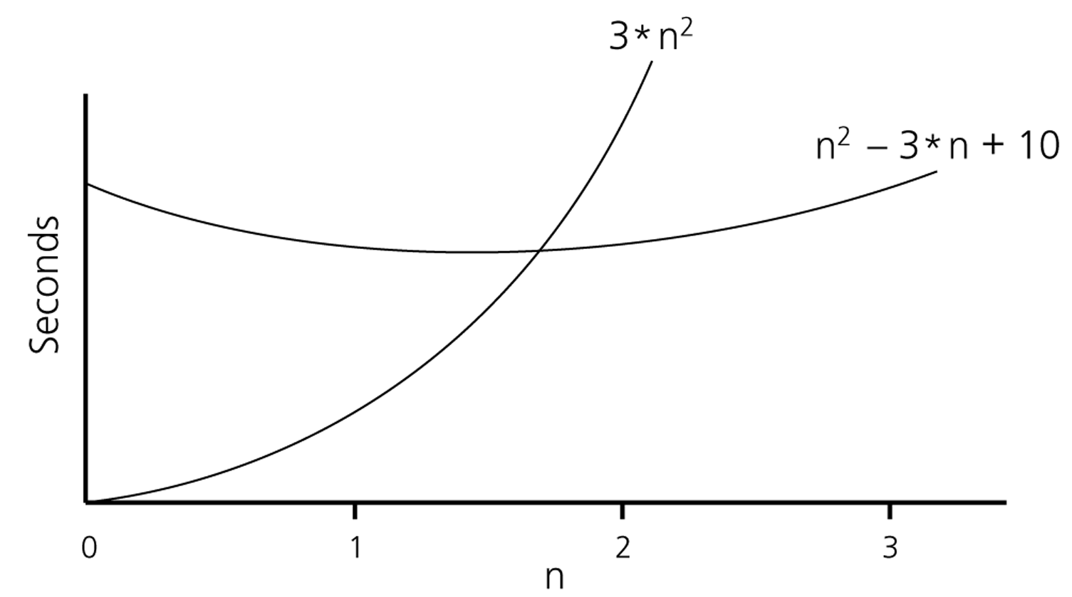
Example
Show that is order of
  Show that there exist constants c and n₀ that satisfy the condition
Try c = 3 and n₀ = 2

Slide 6
How to Determine the Relative Growth Rate?
If lim_{N->∞} T(N) /f(N)
  = 0: T(N) = o(f(N)) (and O(f(N)) for sure)
  = c != 0: T(N) = Θ(f(N))
  = infinity: f(N) = o(T(N))

Slide 7
Big-O Toolbox
(for positive monotonic functions)
Constants do not matter!
  If T(N) = O(f(N) + c)) then T(N) = O(f(N))
  If T(N) = O(c*f(N)) then T(N) = O(f(N))
  If T(N) +c = O(f(N)) then T(N) = O(f(N))
  If T(N)*c = O(f(N) then T(N) = O(f(N))
Algebraic properties:
  If T1(N) = O(f(N)) and T2(N) = O(g(N)) then T1(N)+T2(N) = O(f(N) + g(N))
  If T1(N) = O(f(N)) and T2(N) = O(g(N)) then T1(N)*T2(N) = O(f(N) * g(N))
  If T1(N) = O(f(N)) and g(x) is monotonic, then g(T1(N)) = O(g(f(N))
Dominated terms do not matter:
  If T(N) = O(f(N) + g(N)) and g(N) = o(f(N)) then T(N) = O(f(N))

Slide 8
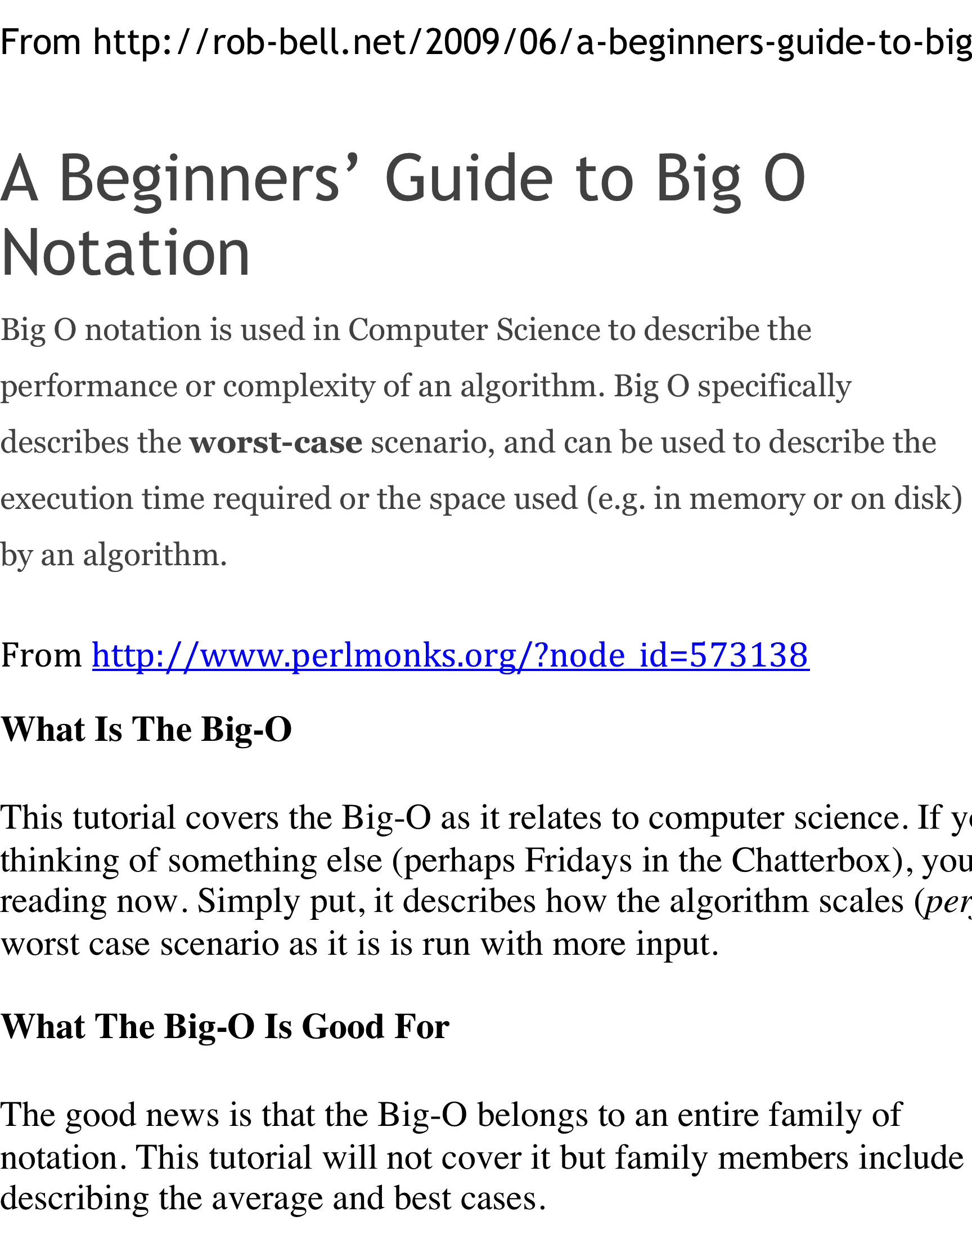
Misconceptions
From http://www.perlmonks.org/?node_id=227909
An informal introduction to O(N) notation
Quite often, when an algorithm's growth rate is characterized by some mix of orders, the dominant order is shown, and the rest are dropped. O(N²) might really mean O(N² + N).
Notes:
Big-O is often used to make statements about functions that measure the worst case behavior of an algorithm, but big-O notation doesn’t imply anything of the sort.
If someone is talking about the randomized QuickSort and says that it is O(nlogn), they presumably mean that its expected running time is O(nlog⁡n). If they say that QuickSort is O(n2) they are probably talking about its worst case complexity. Both statements can be considered true depending on what type of running time the functions involved are measuring.

Slide 9

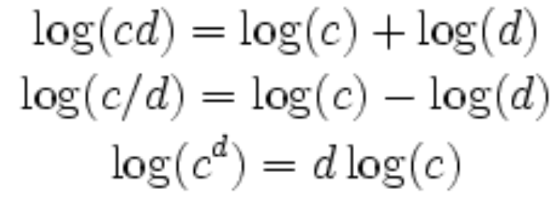
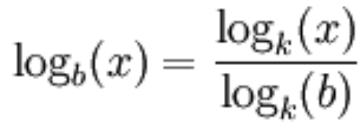
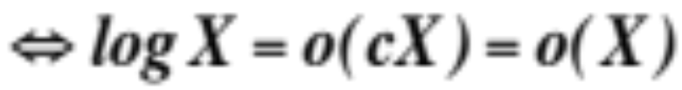
Logarithm Properties
Non-negative, monotonic function for N ≥ 1
Sub linear growth:
Basic equivalencies:
Corollary: logarithm grows slower than any polynomial!

Slide 10
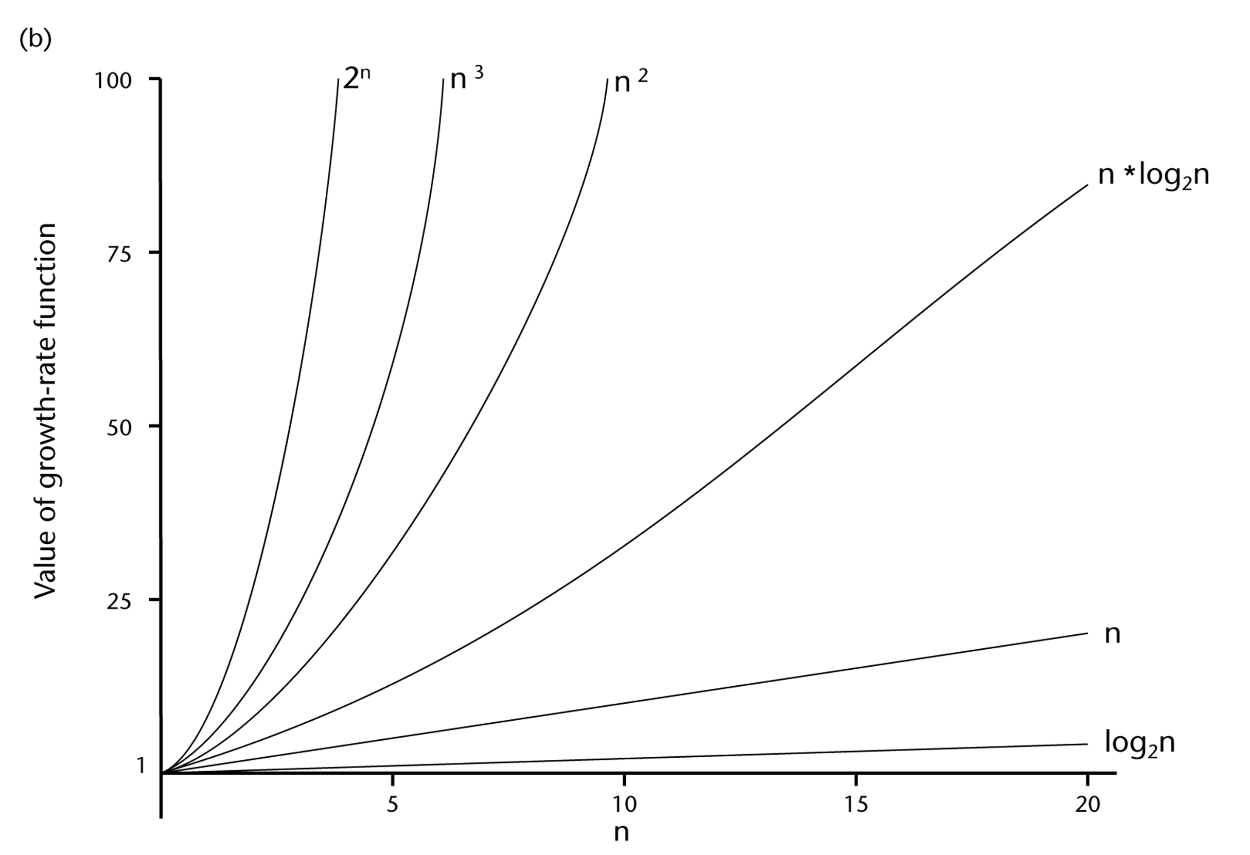
A Comparison of Growth-Rate Functions

Slide 11
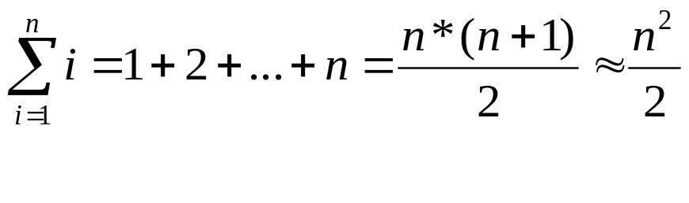
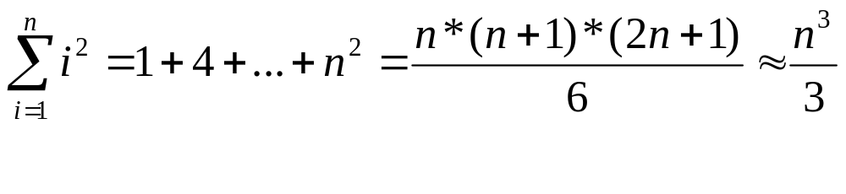
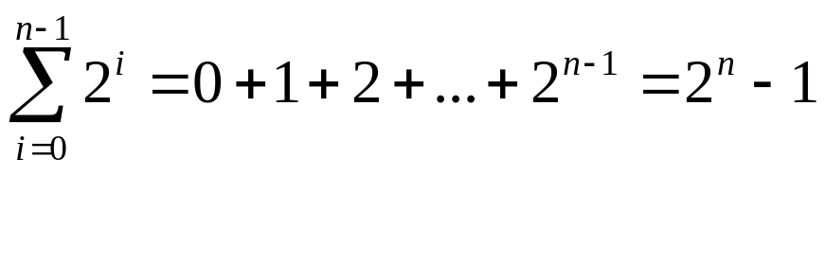
Some Useful Mathematical Equalities

Slide 12
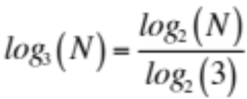
Relative Growth Rates
Examples (which grows faster?)
  1000000 versus 0.01*sqrt(N)
  log(N) versus sqrt(N)
  Nlog(N) versus N^{1.001}
  N³ versus 10000*N²
  log²(N) versus 10*log(N⁵)
  2*log₂(N) versus log₃(N)
  N*2^{N} versus 3^{N}
N^{1.001}= N* N^{0.001}
10*log(N⁵) = 50*log(N)
3^{N =} 1.5^{N *}2^{N}

Slide 13
Algorithm Analysis
Models and Assumptions
  Consider rather abstract algorithm (a procedure or method)
  Ignore the details/specifics of a computer
  Assume sequential process (a sequence of instructions)
  Ignore small constant factors (e.g., differences among “primitive” instructions)
  Ignore language differences (e.g., C++ versus Java)
Average-case versus worst-case performance
  Example: finding a person in phonebook using sequential search
    Best-case?
    Worst-case?
    Average-case?

Slide 14
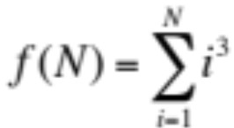
How to Calculate Running Time?
A simple example: compute
  public static int sum(int n)
  {
  int partialSum = 0;
  for (int i = 1; i <= n; i++)
  partialSum += i*i*i;
  return partialSum;
  }
Assume each operation takes unit time, total time is “around” 6N+4
Time complexity O(N)
More accurately Θ(N) in this example

Slide 15
General Rules
Simple statement: constant
  i++; i<n; etc.
Simple loops: # of iterations times the cost of the loop body
  i = 0; While (i < n) { … i++; …}
Nested loops: (the product of # of iterations of outer and inner loops) times (the cost of the inner loop body)
  for (i=0; i < n; i++)
  for(j=0; j < m; j++)
  k++;
Consecutive statements: count the more expensive one
  i = 0;
  while (i < n) { … i++; …}
  for (i=0; i < n; i++)
  for(j=0; j < n; j++)
  k++;
If/else statement: count the more expensive branch (for worst-case analysis)

Slide 16
Running time in Recursive Methods
Recursion often makes analysis more difficult.
A simple one:
  public static long factorial (int n)
  {
  if (n <= 1 )
  return 1;
  else
  return n * factorial ( n - 1 );
  }
Count the number of recursive calls (and the cost of each call)

Slide 17
Recursion – Fibonacci Example
  public static long fib( int n )
  {
  if (n <= 1)
  return 1;
  else
  return fib(n - 1) + fib(n - 2);
  }
Redundant calculation of the same Fibonacci numbers, results in exponential running time
fib(5)
fib(4)
fib(3)
fib(3)
fib(2)
fib(2)
fib(1)
fib(2)
fib(1)

Slide 18
An Example: Maximum Subsequence Sum
Given an array of (possibly negative) integers A[1…N], find the maximum sum of a sub-array A[i…j].
example: 4 5 -6 -6 2 3 5 -8 -1 4 3 7 -2

Slide 19
Algorithm 1
Cubic running time: exhaustively try all possibilities
  public static int maxSubSum1( int [ ] a )
  {
  int maxSum = 0;
  for (int i = 0; i < a.length; i++)
  for( int j = i; j < a.length; j++)
  {
  int thisSum 0;
  for ( int k = i; k <= j; k++)
  thisSum += a[k];
  if ( thisSum > maxSum )
  maxSum = thisSum;
  }
  }
Running time O(N³)
4 5 -6 -6 2 3 5 -8 -1 4 3 7 -2

Slide 20
Algorithm 2
Quadratic running time
  public static int maxSubSum2( int [] a)
  {
  int maxSum = 0;
  for( int i = 0; i < a.length; j++ )
  {
  int thisSum = 0;
  for ( int j = i; j < a.length; j++)
  {
  thisSum += a[j];
  if(thisSum > maxSum )
  maxSum = thisSum;
  }
  }
  }
Eliminate the inner loop and reduce the redundant additions
Running time O(N²)
4 5 -6 -6 2 3 5 -8 -1 4 3 7 -2

Slide 21
Algorithm 3
Linear running time
  int maxSubSum4( int [ ] a )
  {
  int maxSum = 0, thisSum = 0;
  for( int j = 0; j < a.length; j++ )
  {
  thisSum += a[ j ];
  if( thisSum > maxSum )
  maxSum = thisSum;
  else if( thisSum < 0 ) // The first negative subsequence
  thisSum = 0;
  }
  return maxSum;
  }
  4 5 -6 -6 2 3 5 -8 -1 4 3 7 -2
The moment we find a negative subsequence – dump it and start anew from just beyond this point
  It can’t start the max subsequence
  Neither can any of its suffixes
Notes:
A suffix of a negative subsequence has to be negative: indeed any prefix is positive (since this is the first negative subsequence at this position), and if the suffix also was positive, the entire subsequence would have been positive. Said differently: A suffix of a negative subsequence can’t start the max subsequence because the corresponding prefix would be positive (indeed, any prefix of this negative subsequence is positive since this is the first negative subsequence starting from this position) and adding it would have only increase the max.

Slide 22
Another Example: Euclid’s Algorithm
Find the Greatest Common Divisor of two positive integers (m and n)

Slide 23
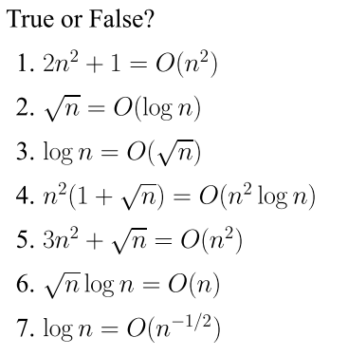
Problem of the Day

Slide 24
Problem of the Day

Slide 25
Problem of the Day

Slide 26
Problem of the Day

Slide 27
Problem of the Day

Slide 28
Problem of the Day

Slide 29
Problem of the Day

